Slide 1

Snakemake: modern descendant of the original 70s software workhorse
Environmental Bioinformatics
30 November + 2 December 2021

Slide 2
[Day 1] – Reproducible workflows

Slide 3
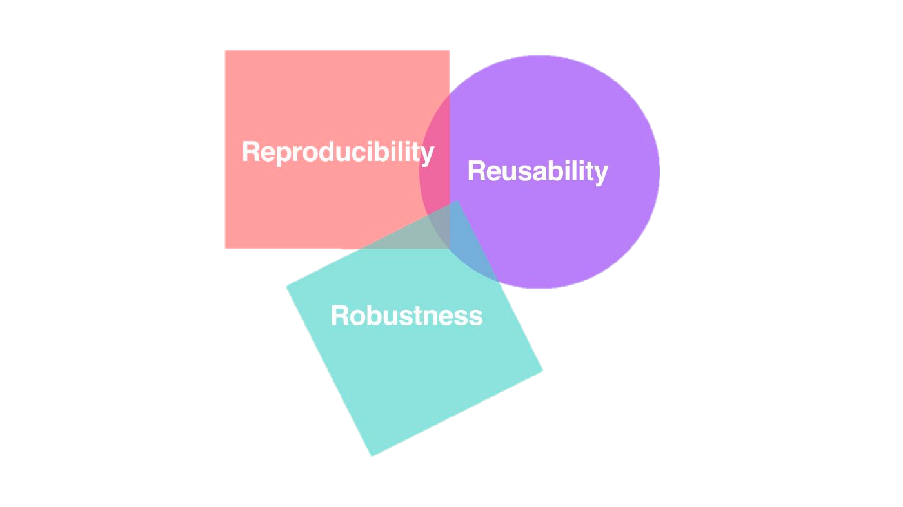
What is reproducibility anyway?
Replicability is completely starting an experiment over and re-doing it start-to-finish to see if you can get the same outcomes
This can be a tall order, especially if the replicates are biological!
Reproducibility, on the other hand, is taking the data and re-doing someone’s analysis

Slide 4
What sorts of barriers exist to reproducing a workflow?
The steps might not be fully documented
The original data might be missing

Slide 5
Reproducible workflows are the next generation of data analysis
Researchers are increasingly committed to improving data integrity and extensibility as datasets grow larger
Two major challenges to reproducible workflows:
Interactions with software & infrastructure
Ordered execution of each step in the analysis

Slide 6
Data-intensive biology requires countless conversions, intermediates, & modifications
Data-intensive biology is challenging to make reproducible because:
We often wish to change our workflow piecewise, slightly tweaking parameters & re-running the analysis
Software tools often produce a lot of intermediate files…and not all file formats are created equal
Small errors in intermediates can cause big headaches downstream
Users with limited computational experience may lack exposure to workflow approaches

Slide 7
Some approachable web-based tools exist for workflow development
Notes:
ebi.ac.uk/metagenomics/

Slide 8
Some approachable web-based tools exist for workflow development
Notes:
Usegalaxy.org

Slide 9
Other workflow development managers use script-based approaches

Slide 10
Not all workflow managers are created equal…but different managers are better for different jobs.
Snakemake is a leading choice for Python-based development…but does require a working knowledge of Python.
Nextflow is often preferable if you use a lot of traditional bioinformatics workflow approaches & want to easily pivot between languages.

Slide 11
We’ll focus on Snakemake for this course.
Snakemake is a Python-based workflow management software that defaults to the use of configuration files + a mix of Python & shell script code.
Arguments about workflow management software can be endless…but the important part is that the workflow is documented at all!

Slide 12
Some elements of reproducibility apply to all workflow management tools.
Self-documenting names for code & files
Making sure before, during, and after analysis that your files + variables are named using information about what is contained in them!
Visualization and documentation
Using notebooks or README files to explain the process (even if they’re used in the workflow development phase) can help other users quickly catch your train of thought.
@iamdevloper

Slide 13
Discussion questions
What kinds of experiences have you had with workflows over the course of the semester?
Is reproducibility important outside of the classroom setting?
What challenges does using conda create? What challenges does it resolve?
How should we plan for tomorrow’s reproducible workflows?

Slide 14
[Day 1] - Downloading Snakemake with conda

Slide 15
conda create –n snakemake –c conda-forge –c bioconda snakemake mamba

Slide 16
[Day 1] Trying out creating a Snakemake workflow!
“Running before we can walk”

Slide 17
Step 1: Creating a fresh directory for our Snakemake workflow
mkdir –p tester-snakemake
vim Snakefile
Snakefile
import os
import pandas as pd
rule all:
input:
“rule_output.txt”
rule make_output:
output:
“rule_output.txt”
shell:
”””
touch {output}
”””

Slide 18
Running our newly-created Snakemake workflow
This minimal working example of Snakemake (we’re just creating a single file) is best run locally on the command line.
To execute it, we’ll run snakemake –-cores 1
(Make sure your Snakemake conda environment is activated).

Slide 19
[Day 2] – Snakemake, high-performance computing, & bioinformatics

Slide 20
Icebreaker activity: brainstorm file processing
I have 3 FASTA files (file1.fasta, file2.fasta, and file3.fasta), each with a set of 100 short sequence fragments that look something like this:
>Seq1 Daphnia_pulex
AGTCAAAGGGTTTCGATAGA
>Seq2 Fragilariopsis_cylindrus
TTGCAGATTACCGATACCTA
There is a space between the FASTA ID and the rest of the header that I don’t want.

Slide 21
Pairs challenge: reformat the 3 FASTA files programmatically
With a partner, brainstorm how I can remove the space between the id and the header in a way that (1) protects the rest of the file content and (2) keeps a record of my work.
file1.fasta
>Seq1 Daphnia_pulex
AGTCAAAGGGTTTCGATAGA
>Seq2 Fragilariopsis_cylindrus
TTGCAGATTACCGATACCTA
…
file2.fasta
>Seq1 Emiliania_huxleyi
AGTCAAAGGGTTTCGATAGA
>Seq2 Pseudo-nitzschia
TTGCAGATTACCGATACCTA
…
file3.fasta
>Seq1 Thalassiosira_pseudonana
AGTCAAAGGGTTTCGATAGA
>Seq2 Phaeocystis_pouchetti TTGCAGATTACCGATACCTA
…

Slide 22
There are no limits on the approaches you can use for this!
Feel free to use shell scripting, Python, or brute force approaches to solve this problem
Choose the approach that you’d (1) be most likely to use and (2) think would be most efficient.

Slide 23
What is Make?
The key paradigm of software development: extensibility.
For this reason, we often desire to build software using utilities that other people (or we ourselves) made previously.
Make can generate an executable from source code & automatically update project components.
GNU
Make

Slide 24
But Make can be a little cryptic.
Usually, we just use Make as an end user
You may have installed software before and been given the prompt to copy/paste make install as part of the instructions
Software developers are the ones most typically likely to use Make.
Notes:
https://interrupt.memfault.com/blog/gnu-make-guidelines#what-is-gnu-make

Slide 25
Snakemake is Make for everyone…at least everyone that uses Python.
Same concept as Make, where there are a series of rules that are used to produce some final specified product
The rules use the syntax of Python, though, and they are written like Python functions.

Slide 26
You should always keep in mind that Snakemake is written in Python
This means that you can
import the same libraries that you would in Python
call your own or others’ Python code (even if it’s completely unrelated to Snakemake)
write Python functions
name variables the same way you would in Python

Slide 27
What makes Snakemake different than a Python script?
Easy use of a YAML-formatted configuration file
Interpretation of rules
Workflow management (creation & cleanup of files + directories)
Later: submission of jobs to the HPC independently

Slide 28
Snakemake is just one piece of an ecosystem of software & tools
Docker containers & Singularity are directly compatible with Snakemake
You can write in both bash and Python in a single script in Snakemake (and call code you’ve written in other languages)
You can write your code once and deploy it everywhere
Locally
HPC
Cloud computing & servers

Slide 29
How do we get started with Snakemake?
The best way to download Snakemake is with conda. You’ll have already downloaded Snakemake for today’s session, but in the future, it can be downloaded via:
conda install –c conda-forge –c bioconda snakemake
But, you probably want to either download Snakemake with mamba or make sure that mamba is installed when you use Snakemake (this speeds up downloads)

Slide 30
How the cake is baked: Snakemake’s directed acyclic graph (DAG)
FASTQ files that are poorly named
Inputs
Renamed FASTA files
Desired outputs

Slide 31
What needs to happen to get from our inputs to our desired outputs?
Find the files we want to process from a list or folder
Match each name to its new name
Rename the files
Convert the format to FASTA (seqtk)

Slide 32
What tools can we use to accomplish our goals?
mv for renaming
seqtk for converting between FASTQ and FASTA

Slide 33
How would we process a single file?
Original File Name | Desired File Name
sample1_messy_name.fastq | sample1_processed.fasta
seqtk seq -a sample1_messy_name.fastq > sample1_messy_name.fasta
mv sample1_messy_name.fastq sample1_processed.fasta

Slide 34

Every discrete operation that Snakemake performs is a rule.
Rules can theoretically perform an unbounded number of tasks…but it’s better that they don’t.
Ideally, a rule is a compartmentalized, single accomplishment.

Slide 35
Snakemake rule structure is predictable and ordered.
rule task_name:
input:
variable = file
output:
variable = file
shell:
”””
some code
”””

Slide 36
What if we only wanted to select a few files to process from our folder?
Enter: the config file.

Slide 37
Configuration files provide a lookup table that Snakemake will use for processing.
Folder we store our files in
List of files inside folder
Output folder to save to
Configuration file slots

Slide 38
Snakemake provides infrastructure to install software and manage dependencies.
conda, as has been used frequently throughout this course, is a commonly used tool that manages software versions & dependencies (but not operating systems or software speed).
Snakemake integrates rules directly with conda, such that you can specify the exact version of a tool that will be applied to your data.
One caveat: pay attention to the base environment & Snakemake version that you use.

Slide 39
Creating an environment specification for conda in Snakemake

Slide 40
Snakemake allows us to hook our workflow seamlessly into high-performance computing systems.
Each rule will become an individual job on the HPC (eventually).
First, we should set up Snakemake to run on Poseidon, and create a default profile to use.

Slide 41
Creating a profile to integrate with Snakemake on the HPC.
For the purposes of this class, we’ll focus on modifying the default profile.
Going forward, you might be interested in different profiles for different types of workflows.
Get started by creating a default Snakemake profile directory relative to your user’s root directory.
mkdir ~/.config/snakemake/default
(a –p flag will make sure that the command is silent if the dir exists!)

Slide 42
Next, we’ll open up the profile document using a text editor.
vim ~/.config/snakemake/default/config.yaml
You can use any text editor you prefer!
config.yaml
use-conda: True
jobs: 1
rerun-incomplete: True
printshellcmds: True
Allows us to conda-integrate!
Prevent specifying during dry runs
Rerun things that appear unfinished
Print out the exact shell commands run

Slide 43
Snakemake as part of an ecosystem of workflow management software tools

Slide 44
FAIR data practices
Findable
Accessible
Interoperable
Reproducible

Slide 45
Preparing for two phases of tool use & development
Research workflows :: novel insights or steps; the first time processing has been done in this way.
Production workflows :: steps that need to be performed again & again by necessity and can be ported between broader workflows + projects
(Reiter et al. 2021)

